Slide 1
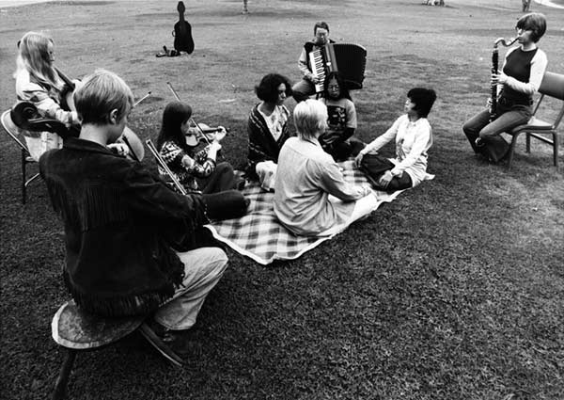


Pauline Oliveros’s investigations into the effects of
Sonic Meditations on behavior and neurophysiology
Barbara Nerness,¹ Tysen Dauer,² Takako Fujioka¹
¹Center for Computer Research in Music and Acoustics (CCRMA), Department of Music, Stanford University, USA
²Rotman Research Institute, Canada
Contact: ¹bnerness@ccrma.stanford.edu

Slide 2
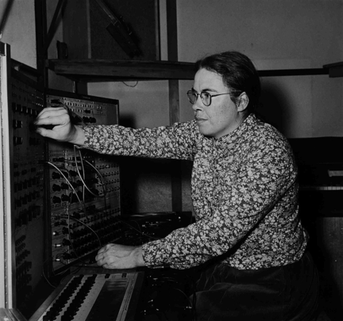
Background
Pauline Oliveros (1932 - 2016)
Composer, performer, feminist
Founding member of the San Francisco Tape Music Center
Professor of electronic music at Mills, UCSD, Oberlin, RPI
Deep listening
Oliveros began the Meditation Project as a reaction to the Vietnam War protests, Kennedy assassination, and student self-immolation at UCSD (Oliveros, 2007)
Notes:
Oliveros was teaching at UCSD when she began the Meditation Project

Slide 3
Background
Meditation Project (1973)
10-week class Oliveros held in 1973 at UCSD
Participants practiced for 2 hours every day:
body awareness exercises
tai chi
yoga
calligraphy
karate
dreamwork
biofeedback began week 5
Sonic Meditations
She hypothesized that these exercises would increase neural alpha power oscillations, and improve musicianship and creativity
Alpha waves (~10 Hz)
sensory processing: occipital alpha (visual), central mu (sensorimotor), temporal tau (auditory)
cognitive functions (attention, memory)
Notes:
In winter 1973, composer Pauline Oliveros led the Meditation Project, a ten-week class at the University of California, San Diego (UCSD) where participants practiced her Sonic Meditations - combining meditation with participatory and improvisatory compositions for imagining, remembering, making, and listening to sounds. Participants also practiced tai-chi, qi-gong, and other techniques. Oliveros collected behavioral and electroencephalography (EEG) data before and after the class but never secured funding for analysis. Because research at the time linked meditation with neurophysiological changes, she hypothesized that the class would increase neural alpha power oscillations and improve musicianship and creativity (Oliveros, 1984).
Biofeedback for alpha wave training started in 5th week

Slide 4
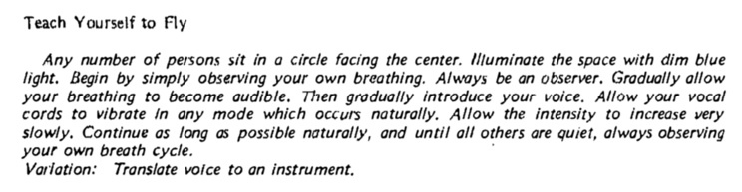
Background
Sonic Meditations: compositions begun in early 1970s with the goal of healing human consciousness
Participatory and improvisatory compositions for imagining, remembering, making, and listening to sounds
Sonic Meditation I (Oliveros, 1974)
Notes:
In winter 1973, composer Pauline Oliveros led the Meditation Project, a ten-week class at the University of California, San Diego (UCSD) where participants practiced her Sonic Meditations - combining meditation with participatory and improvisatory compositions for imagining, remembering, making, and listening to sounds. Participants also practiced tai-chi, qi-gong, and other techniques. Oliveros collected behavioral and electroencephalography (EEG) data before and after the class but never secured funding for analysis. Because research at the time linked meditation with neurophysiological changes, she hypothesized that the class would increase neural alpha power oscillations and improve musicianship and creativity (Oliveros, 1984).
Instructions are meant to have a lot of time in between

Slide 5
Background
Sonic Meditations: compositions begun in early 1970s with the goal of healing human consciousness
Participatory and improvisatory compositions for imagining, remembering, making, and listening to sounds
Sonic Meditation I (Oliveros, 1974)
Notes:
In winter 1973, composer Pauline Oliveros led the Meditation Project, a ten-week class at the University of California, San Diego (UCSD) where participants practiced her Sonic Meditations - combining meditation with participatory and improvisatory compositions for imagining, remembering, making, and listening to sounds. Participants also practiced tai-chi, qi-gong, and other techniques. Oliveros collected behavioral and electroencephalography (EEG) data before and after the class but never secured funding for analysis. Because research at the time linked meditation with neurophysiological changes, she hypothesized that the class would increase neural alpha power oscillations and improve musicianship and creativity (Oliveros, 1984).
Instructions are meant to have a lot of time in between
In the first Sonic Meditation, “Teach Yourself to Fly,” performers are instructed to observe their breathing (Image 4.10). For Oliveros this meant attending to and being aware of breath cycles: focus on them and be simultaneously aware of the cycles’ presence in the environment. With attention staying on the breath, the performer needs to increase air pressure to let the breathing become audible.84 Eventually, participants heighten this audible breath into vocalized drones. Still attending to the breath cycle, awareness may include performers’ drones. Participants’ awareness may continue to expand, resulting in what Oliveros called observation: in this case, the ability to perceive one’s self simultaneously (1) paying attention to breath cycles and (2) being aware of sounds in the environment. This observation may be conscious (in real time) or unconscious (retrievable later in memory). Observing is where performers learn and practice tuning attention and awareness.85

Slide 6
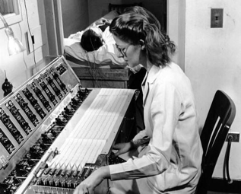
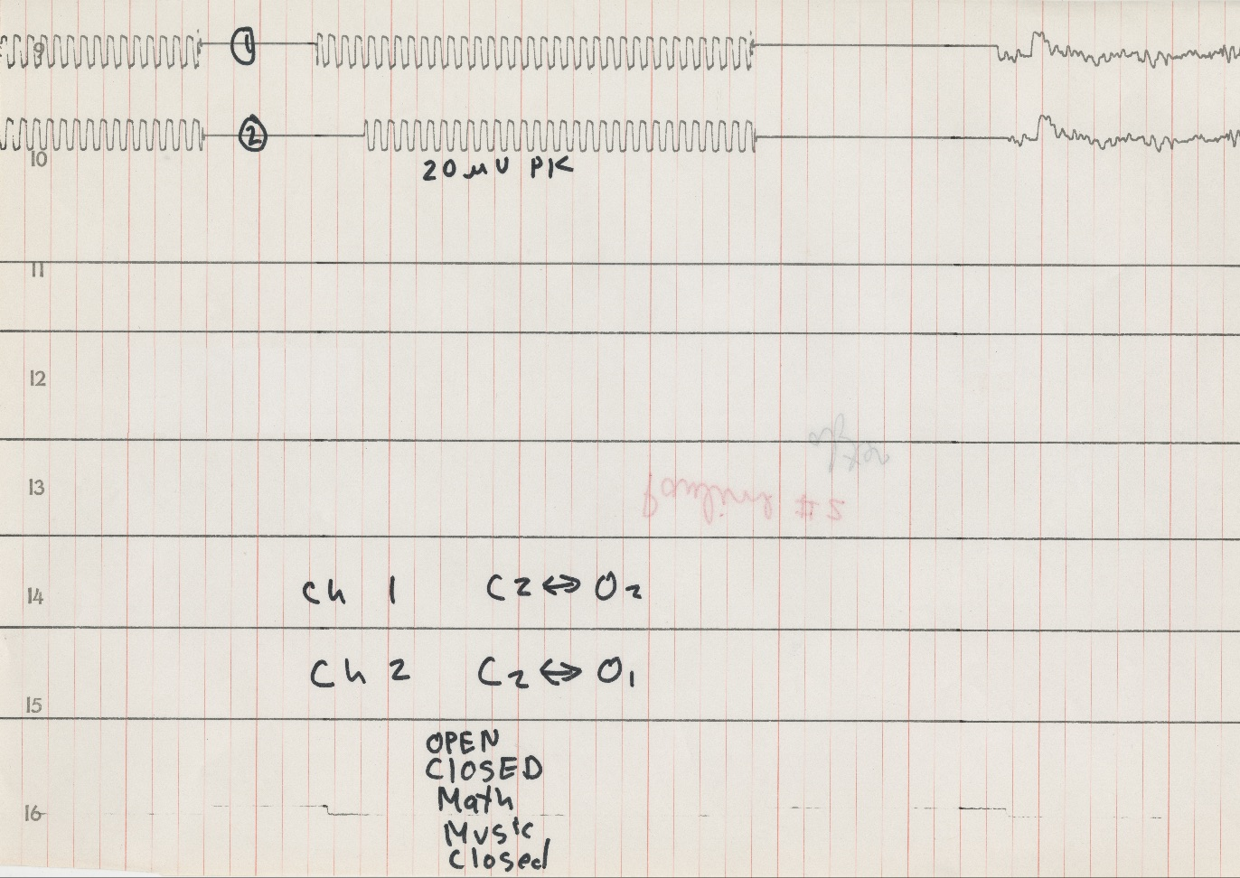
Background
Meditation Project (1973)
20 participants
mostly musicians, some non-musicians
UCSD students, ♀ Ensemble members, and community members
Collected quantitative data before and after to measure changes
Seashore Measurement of Musical Talents (Seashore)
Objective measure of musical skills including pitch, loudness, rhythm, timbre, time, tonal memory
Paired stimulus trials (i.e. same/different, louder/softer, etc.) => overall accuracy
Betts Vividness of Imagery Scale (Betts)
Targets visual, auditory, kinesthetic, and cutaneous (tactile) sensory modalities
Subjective rating of vividness of imagery
Paper EEG recording
Hypothesized that alpha waves, would increase in amplitude, duration, and that it would vary by condition
Conditions: eyes closed, open, math, music - incomplete and inconsistent
Oliveros never received funding for analysis!
Notes:
In winter 1973, composer Pauline Oliveros led the Meditation Project, a ten-week class at the University of California, San Diego (UCSD) where participants practiced her Sonic Meditations - combining meditation with participatory and improvisatory compositions for imagining, remembering, making, and listening to sounds. Participants also practiced tai-chi, qi-gong, and other techniques. Oliveros collected behavioral and electroencephalography (EEG) data before and after the class but never secured funding for analysis. Because research at the time linked meditation with neurophysiological changes, she hypothesized that the class would increase neural alpha power oscillations and improve musicianship and creativity (Oliveros, 1984).
UPPER RIGHT: They must have used a comparable EEG system and here’s the paper example we got
Alpha - condition markings incomplete so we treat all as at rest
-- Oliveros’ hypotheses regarding alpha power most likely came from psychologist Robert Ornstein, whose 1972 book she cites in her published bibliography for the Meditation Project. In the book, Ornstein oversimplifies the association between meditation and alpha oscillations and the promise of biofeedback alpha training for healing the Western mind. Available research at the time associated alpha waves with closed eyes, drowsiness, intoxication, hypnosis, and meditation. The few studies done in the 50s and 60s on alpha and meditation often had few subjects or many subjects but data reported for only select participants.
Seashore: basically a discrimination task
Alpha oscillations: (8-13 Hz frequency band) in scalp-recorded EEG signal, classified by location and functionality: occipital alpha (visual), central mu (sensorimotor), temporal tau (auditory)
Related to attention/memory processing
--------------------------------------------
Because we don’t know specifics of EEG dataset, so collapsed down
No procedure for extracting duration, and recording sessions all different lengths
Conditions unreliable

Slide 7
Aims
Analyze participants’ data to understand if the class
improved musicianship and creativity
increased neural alpha power oscillations
Review literature to examine how Oliveros’ hypotheses
are motivated by research in the 1960s/70s
intersect with recent findings in meditation, neurophysiology, and music
Notes:
Our aims were twofold,
First, to analyze …
Secondly, ...

Slide 8
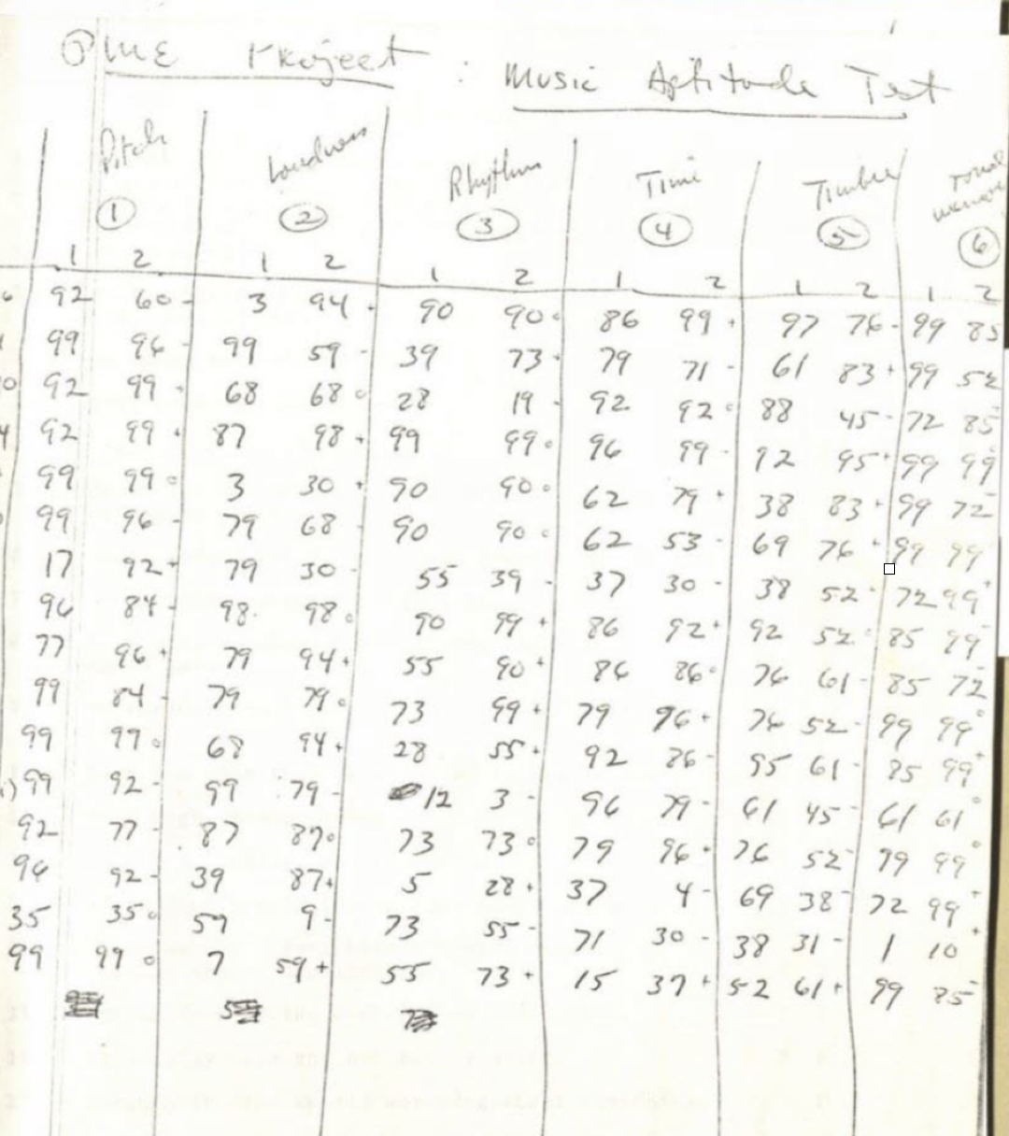
Methods
Meditation Project (1973)
We asked UCSD special collections to produce high resolution scans of:
Behavioral
Seashore
16 participants
Betts
16 participants
EEG
640 pages of high resolution scans
11 participants with before and after data
6 participants with only before
2 participants with only after
Recorded at 2 occipital electrode sites
(O1, O2)
Diaries from 7 participants
Notes:
In winter 1973, composer Pauline Oliveros led the Meditation Project, a ten-week class at the University of California, San Diego (UCSD) where participants practiced her Sonic Meditations - combining meditation with participatory and improvisatory compositions for imagining, remembering, making, and listening to sounds. Participants also practiced tai-chi, qi-gong, and other techniques. Oliveros collected behavioral and electroencephalography (EEG) data before and after the class but never secured funding for analysis. Because research at the time linked meditation with neurophysiological changes, she hypothesized that the class would increase neural alpha power oscillations and improve musicianship and creativity (Oliveros, 1984).
Save time: only mention

Slide 9
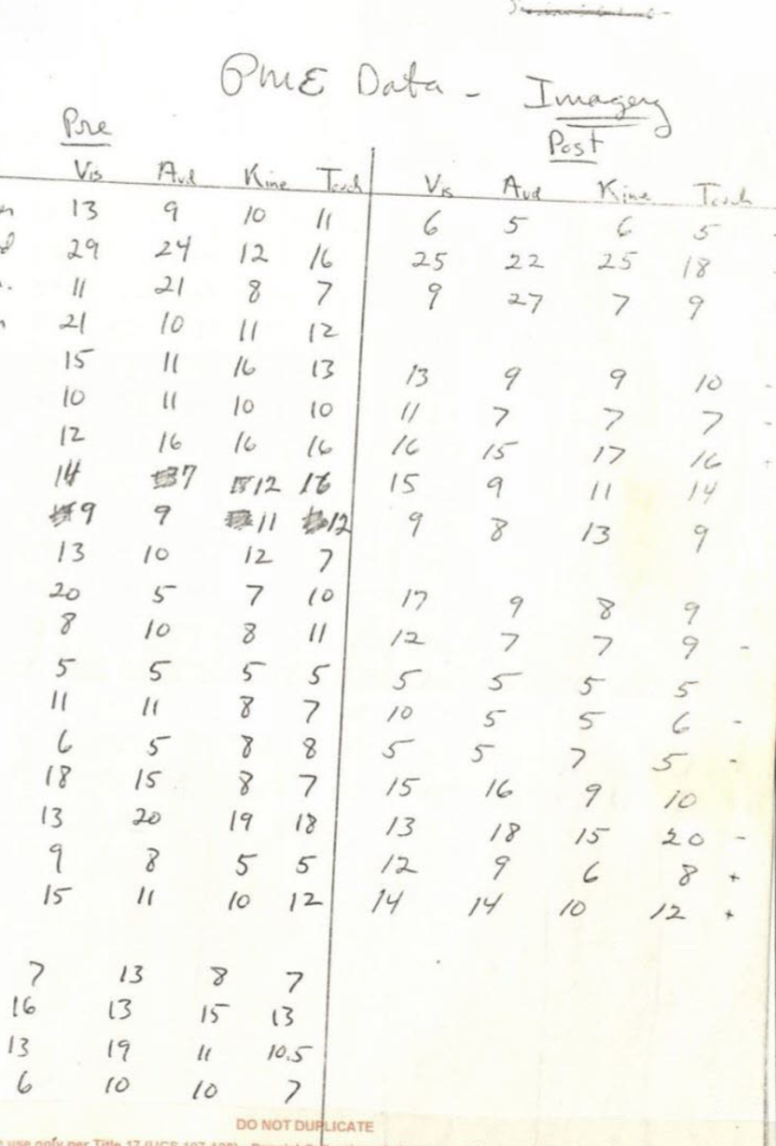
Methods
Meditation Project (1973)
We asked UCSD special collections to produce high resolution scans of:
Behavioral
Seashore
16 participants
Betts
16 participants
EEG
640 pages of high resolution scans
11 participants with before and after data
6 participants with only before
2 participants with only after
Recorded at 2 occipital electrode sites
(O1, O2)
Diaries from 7 participants
Notes:
In winter 1973, composer Pauline Oliveros led the Meditation Project, a ten-week class at the University of California, San Diego (UCSD) where participants practiced her Sonic Meditations - combining meditation with participatory and improvisatory compositions for imagining, remembering, making, and listening to sounds. Participants also practiced tai-chi, qi-gong, and other techniques. Oliveros collected behavioral and electroencephalography (EEG) data before and after the class but never secured funding for analysis. Because research at the time linked meditation with neurophysiological changes, she hypothesized that the class would increase neural alpha power oscillations and improve musicianship and creativity (Oliveros, 1984).

Slide 10
Methods
Meditation Project (1973)
We asked UCSD special collections to produce high resolution scans of:
Behavioral
Seashore
16 participants
Betts
16 participants
EEG
640 pages of high resolution scans
11 participants with before and after data
6 participants with only before
2 participants with only after
Recorded at 2 occipital electrode sites
(O1, O2)
Diaries from 7 participants
Notes:
In winter 1973, composer Pauline Oliveros led the Meditation Project, a ten-week class at the University of California, San Diego (UCSD) where participants practiced her Sonic Meditations - combining meditation with participatory and improvisatory compositions for imagining, remembering, making, and listening to sounds. Participants also practiced tai-chi, qi-gong, and other techniques. Oliveros collected behavioral and electroencephalography (EEG) data before and after the class but never secured funding for analysis. Because research at the time linked meditation with neurophysiological changes, she hypothesized that the class would increase neural alpha power oscillations and improve musicianship and creativity (Oliveros, 1984).

Slide 11
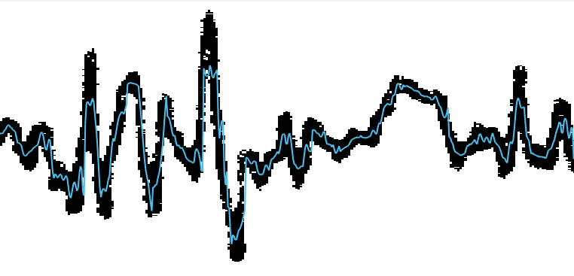
Methods
Meditation Project (1973)
Original data received from UCSD special collections
Behavioral
Seashore
16 participants
Betts
16 participants
EEG
640 pages of high resolution scans
11 participants with before and after data
6 participants with only before
2 participants with only after
Recorded at 2 occipital electrode sites
(O1, O2)
Diaries from 7 participants
Notes:
In winter 1973, composer Pauline Oliveros led the Meditation Project, a ten-week class at the University of California, San Diego (UCSD) where participants practiced her Sonic Meditations - combining meditation with participatory and improvisatory compositions for imagining, remembering, making, and listening to sounds. Participants also practiced tai-chi, qi-gong, and other techniques. Oliveros collected behavioral and electroencephalography (EEG) data before and after the class but never secured funding for analysis. Because research at the time linked meditation with neurophysiological changes, she hypothesized that the class would increase neural alpha power oscillations and improve musicianship and creativity (Oliveros, 1984).

Slide 12
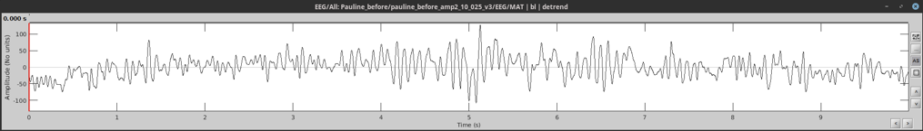
Methods
Meditation Project (1973)
Analysis
Behavioral
Linear mixed effects model because we had multiple subsections in each test
EEG
Digitized paper EEG
Custom MATLAB image processing scripts
Eliminated artifact-contaminated segments (2 seconds)
power spectral density (PSD, 1-60 Hz)
t-test for before/after comparison
validation: PSD from new EEG recording taken at rest
Literature review
1960s to the present
Keywords: alpha, EEG, ERP, P3, meditation, mindfulness, attention, musical skills, musical ability, creativity, neurofeedback, state, trait
Notes:
We acquired high-resolution scans of the original paper EEG recorded at two occipital sites from UCSD Special Collections, along with behavioral data (Seashore Measurement of Musical Talent and Betts Vividness of Imagery Scale) and diaries from the 20 participants. For the 16 participants with Seashore and Betts tests, we ran a linear mixed effects model to determine if there were significant differences between scores before and after. Only 11 participants recorded EEG data both before and after. After digitizing the paper EEG, we eliminated artifact-contaminated segments and calculated power spectral density (PSD, 1-60Hz) for before/after comparison. To validate EEG characteristics, we obtained the PSD from a new EEG recording during rest. We also examined meditation-related EEG research literature from before 1973 to the present.

Slide 13
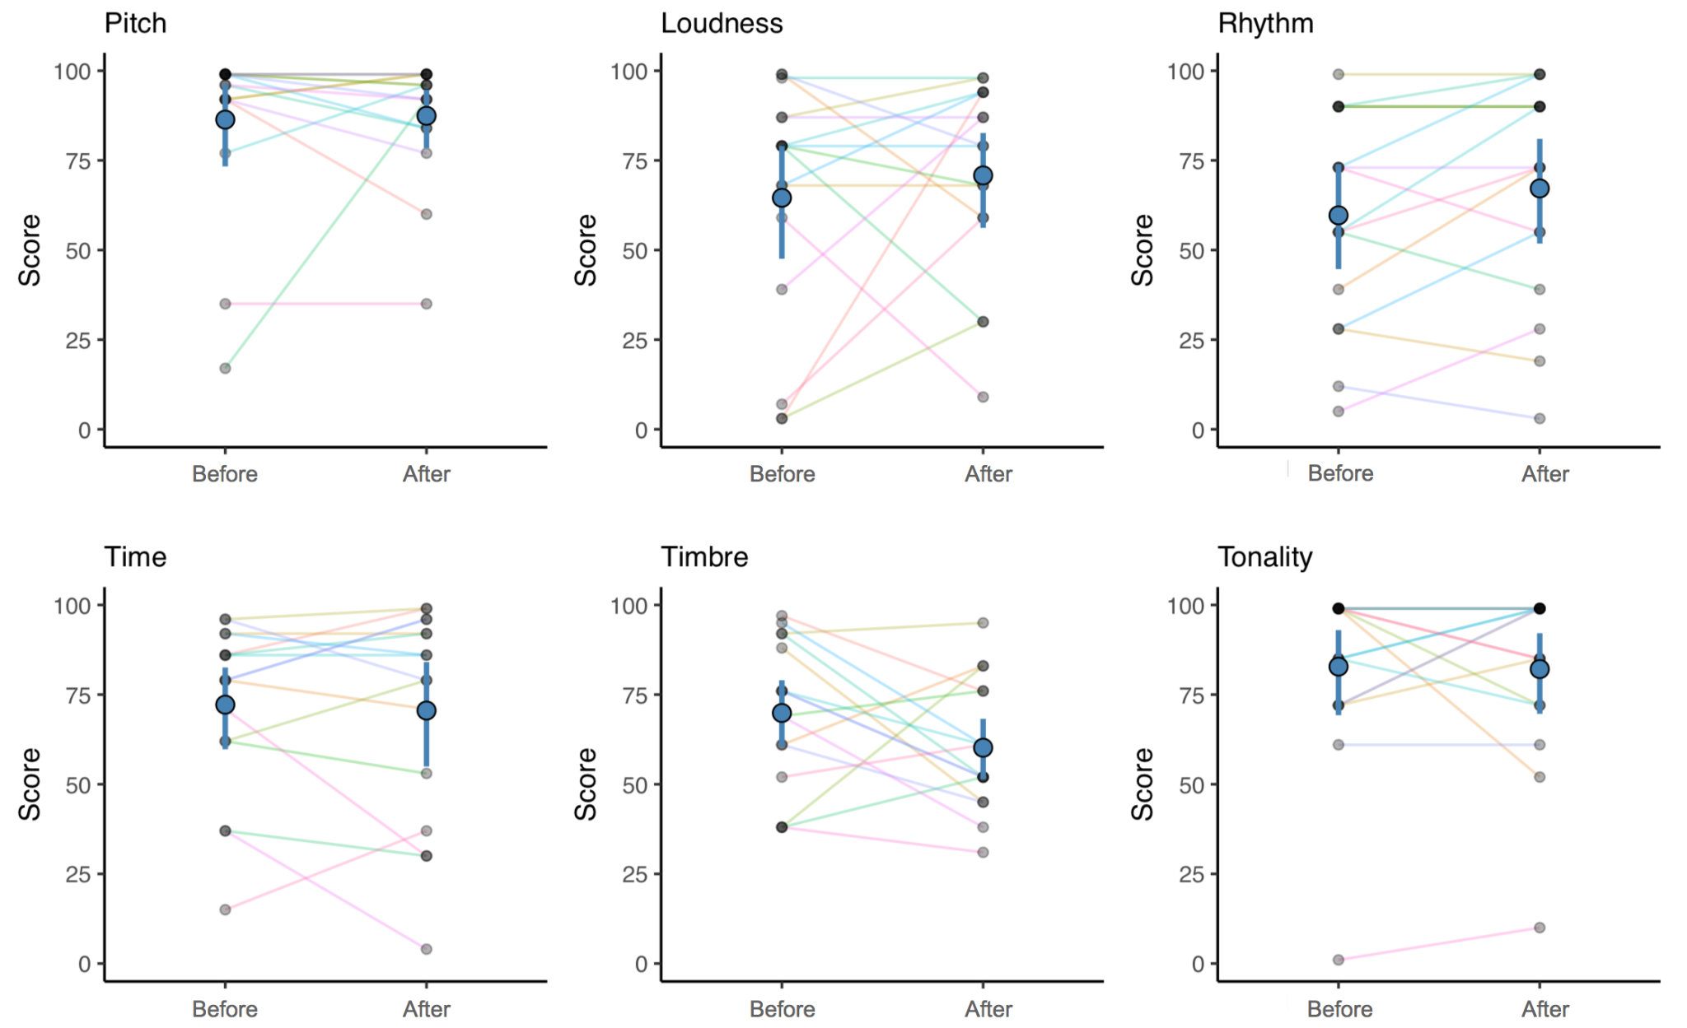
Results (Seashore)
Take-aways
Individual variability
Range of scores reflect mixture of musicians and non-musicians
Discussion
Out of print, little modern validity/reliability testing
Seashore used in 50s/60s educational/vocational settings
Assumes that higher auditory sensitivity correlates with musical ability
More recent measures: Musical Ear Test, Profile of Music Perception Skills (PROMS), Musical Aptitude Profile, Goldsmiths MSI (subjective)
Little evidence linking musical skills to meditation
Notes:
Shown here are the Seashore results for the six subtests. THere’s quite a bit of individual variability, which reflects the mixture of musicians and non-musicians. The Seashore is out of print, but there are more recent objective measures such as the Musical Ear Test and PROMS, as well as subjective measures such as the Goldsmiths Musical Sophistication Index.
5 min from here on
, musical training/practice

Slide 14
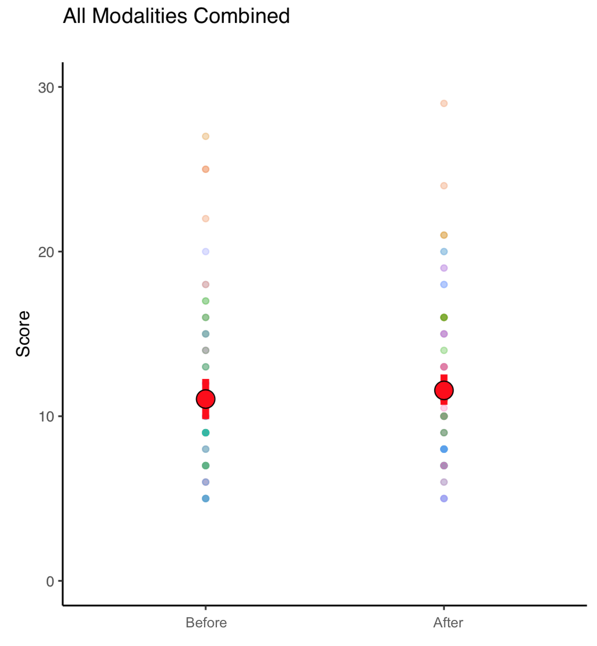
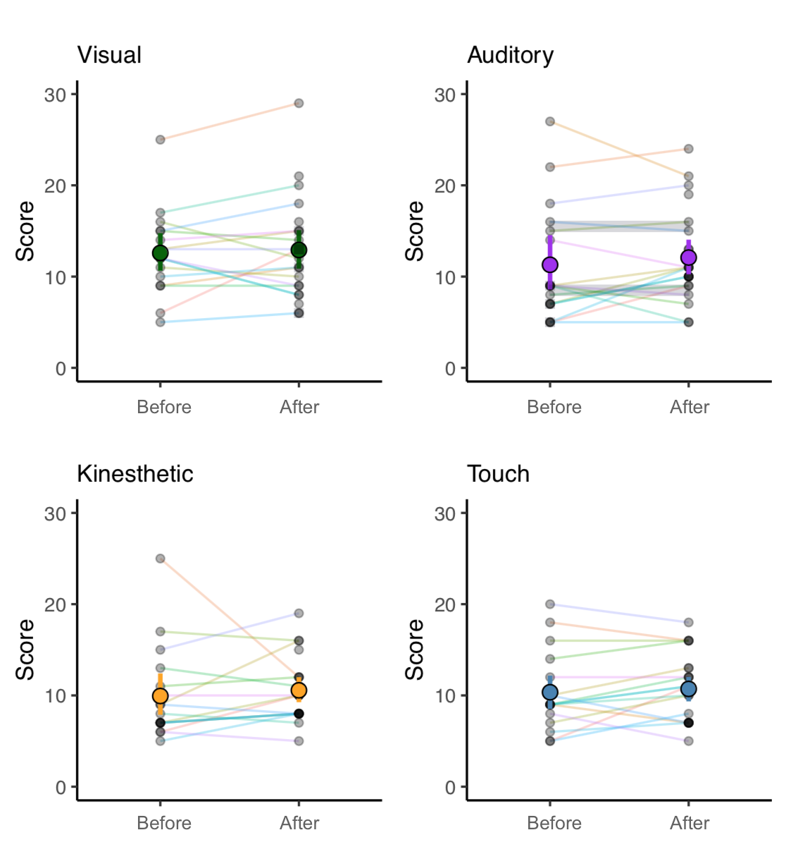
Results (Betts)
Take-aways
No change
Range of scores reflect mixture of participant backgrounds
Discussion
Outdated, unreliable
Sheehan shortened initial Betts Questionnaire (1909) in 1967
Newer measures of sensory imagery with better validation: Plymouth Sensory Image Questionnaire (Andrade et al., 2014)
Musicians score higher on sensory imagery questionnaires (similar to Betts) than nonmusicians (Campos & Fuentes, 2016)
Mindfulness training provides benefits against music performance anxiety and enhanced focus during practice (Lin et al., 2008)
Betts and Seashore scores did not increase afterward
Not surprising given that participants did not specifically train the skills they measured
Notes:
Results for Betts also showed no changes and reflect the mixture of participant backgrounds. Betts is also outdated, but there is one newer measure called the Plymouth Sensory Image Questionnaire, which came out in 2014. Interestingly, musicians score higher than non-musicians, especially on auditory imagery. As for meditation, mindfulness training provides benefits against music perf anxiety and enhanced focus during practice, rather than direct musical skills. Overall, we find Betts and Seashore scores did not increase afterward, which is not surprising given that participants did not specifically train the skills they measured!

Slide 15
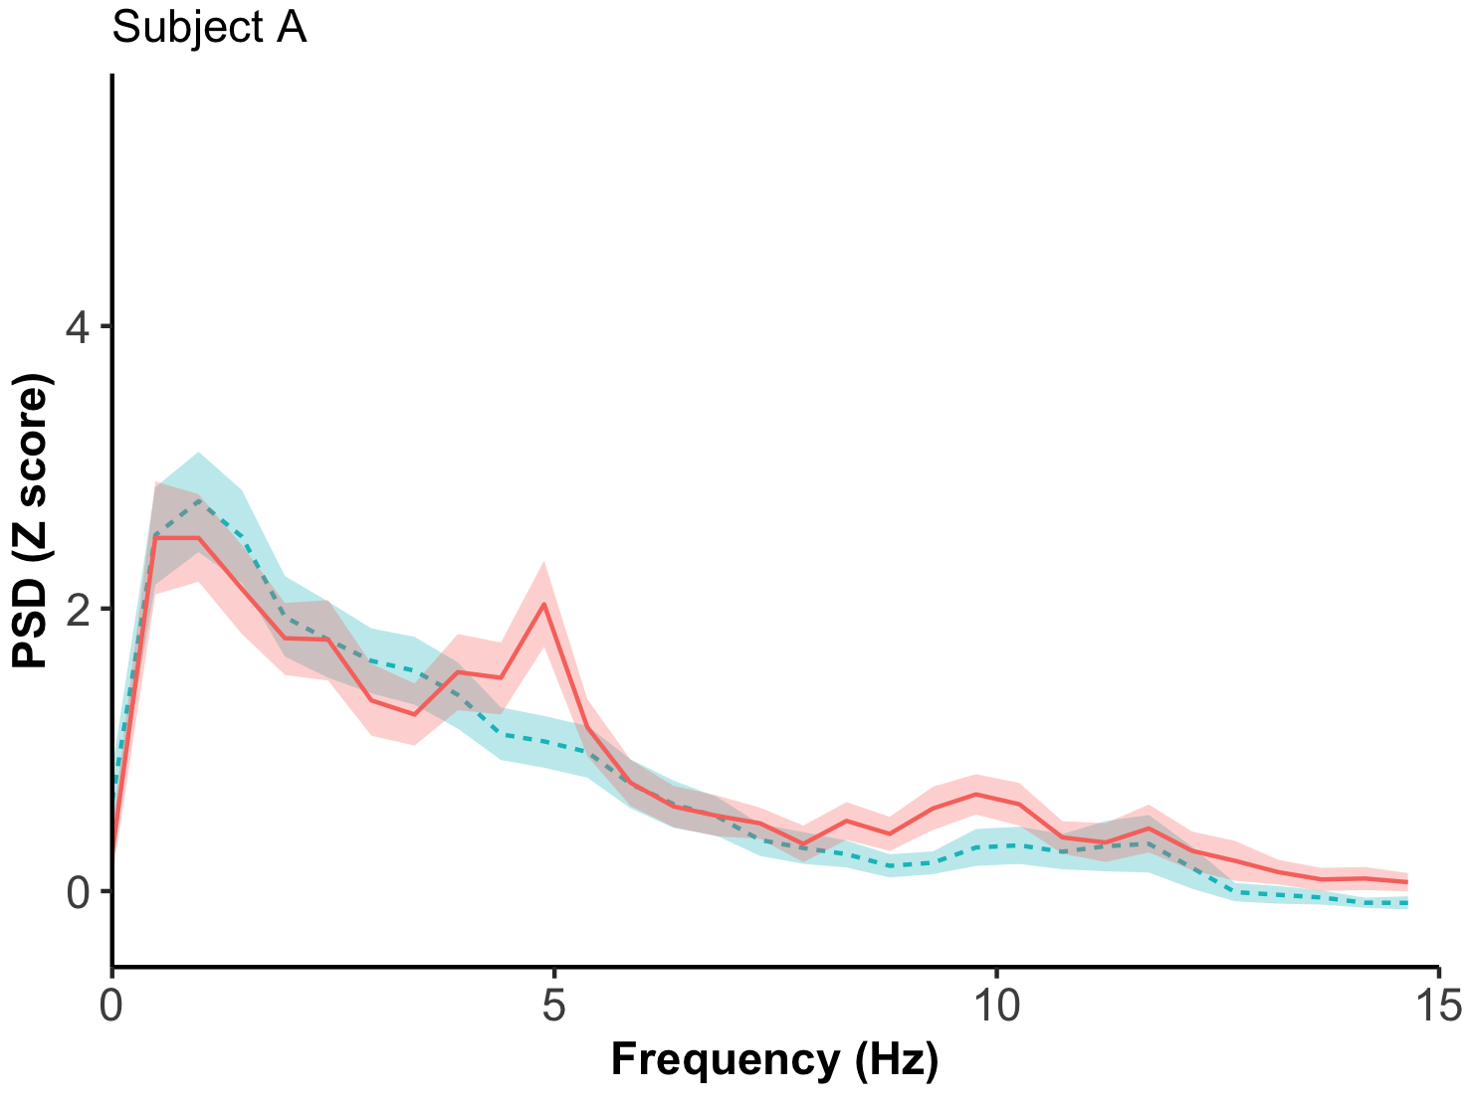
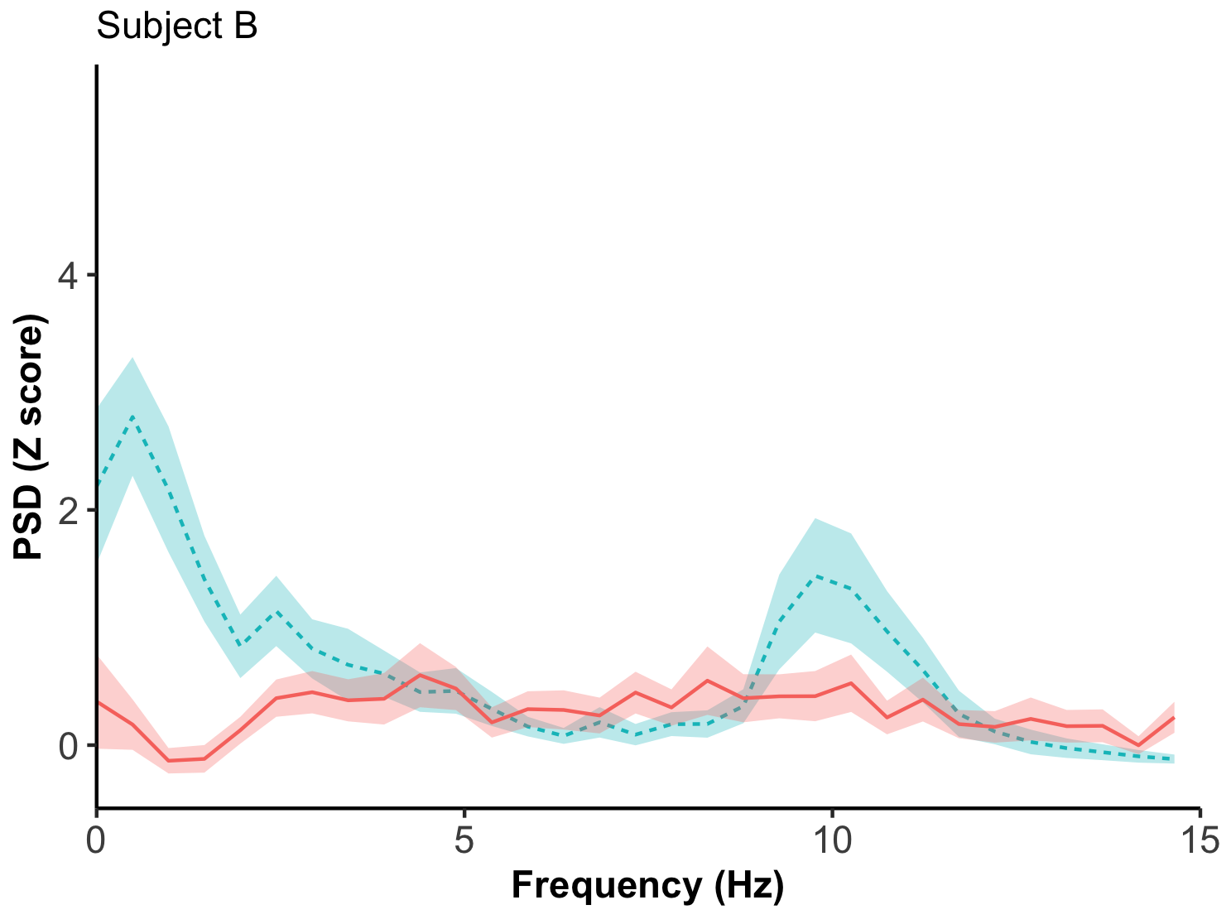
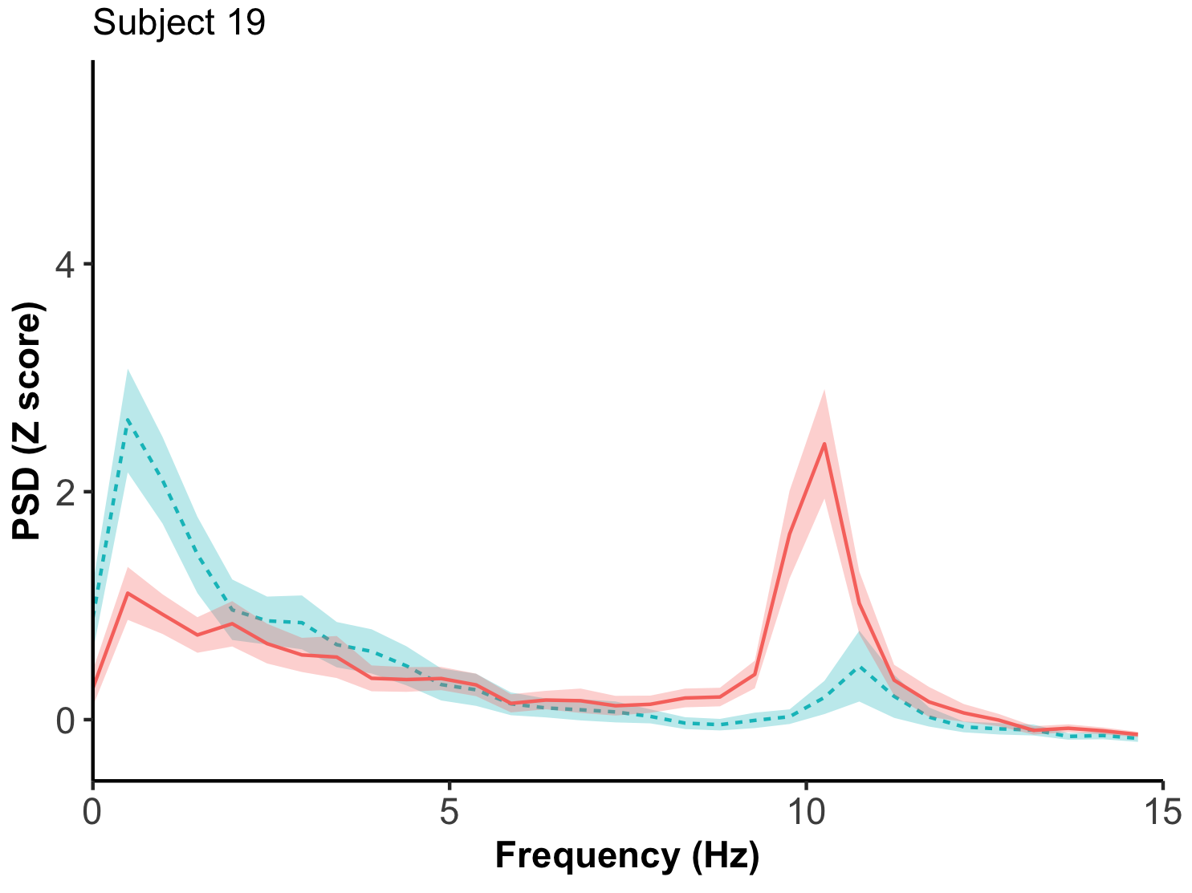
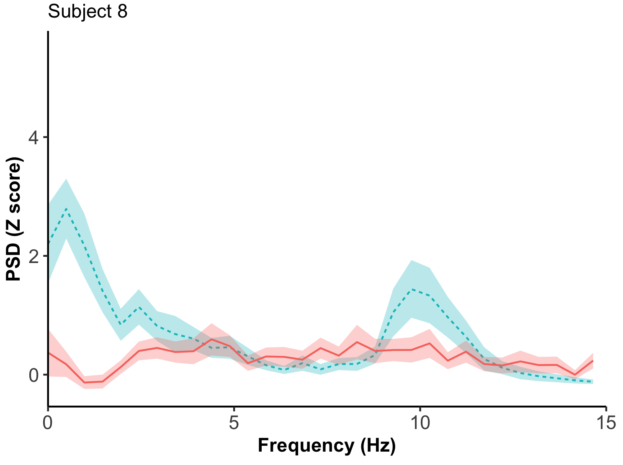
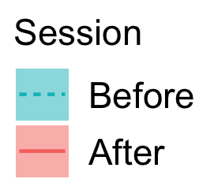
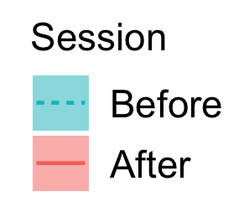
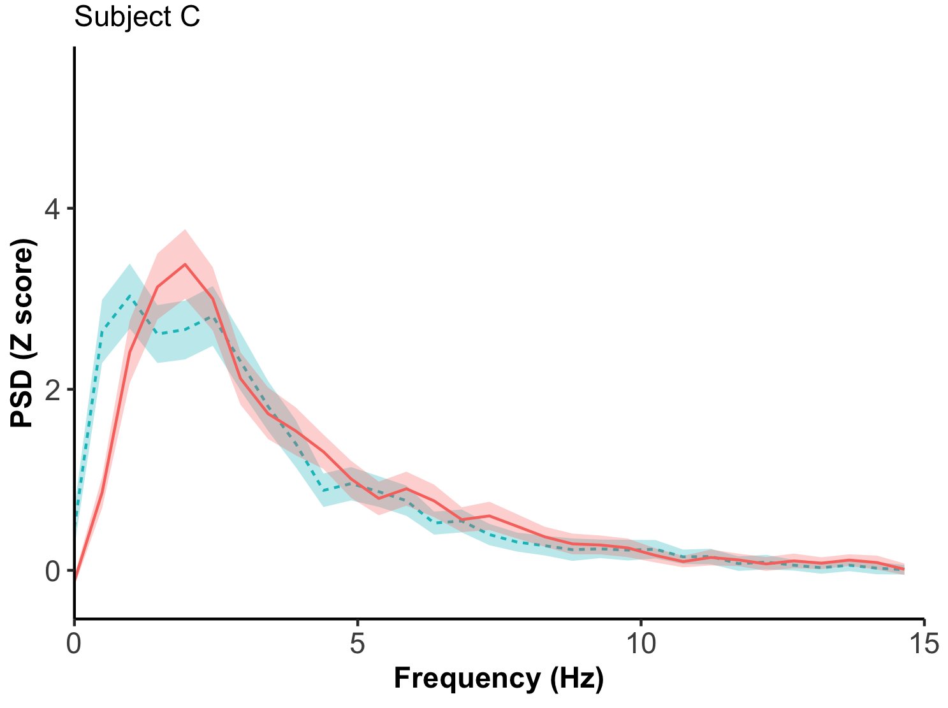
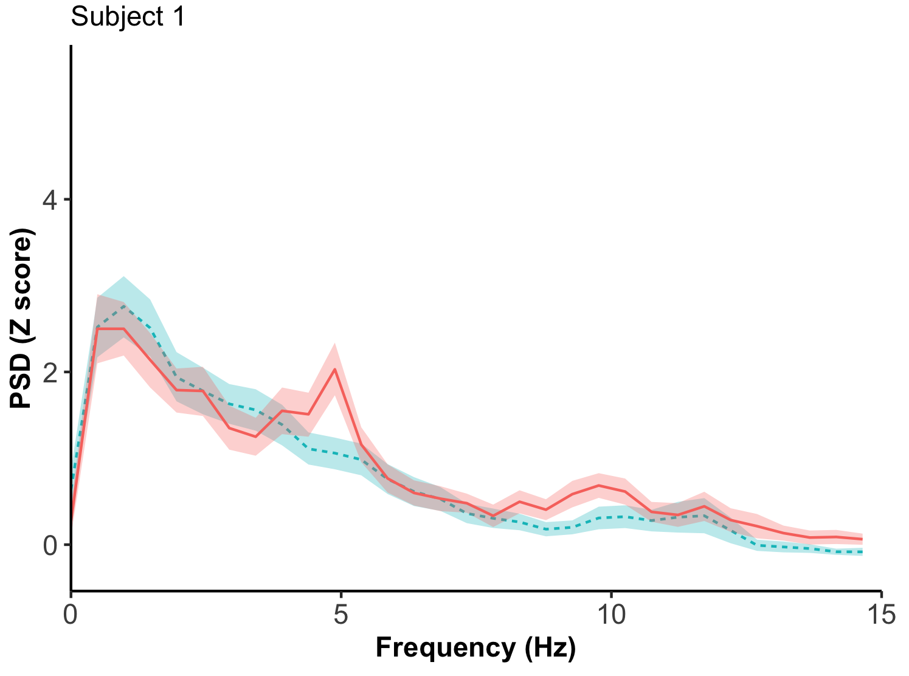

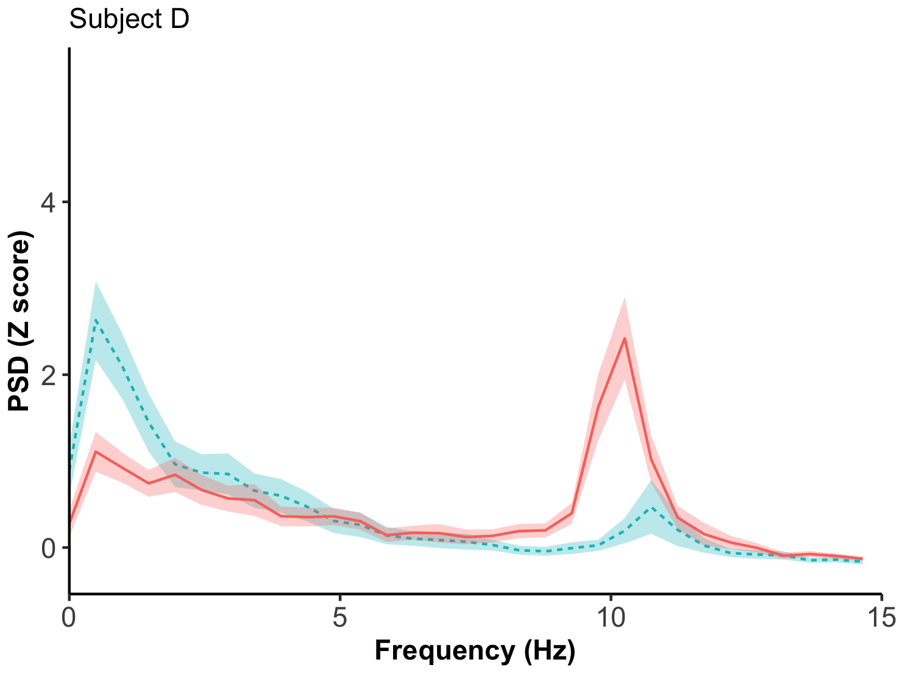
Results (EEG)
Average PSD with 95% confidence interval by session
Individual PSDs
Notes:
First, the individual subjects showed a lot of variability in the EEG recordings, as you can see from these 4 subjects. Some subjects were consistent in both sessions, but some weren’t. There’s low delta energy in almost all sessions, one person with a theta peak here, and some with larger alpha in the before session, and some with larger alpha in the after session.
make subject A,B etc larger; add arrows toward delta, theta, alpha // cut down time explanation: some subjects consistent in both sessions, some aren't; 20 sec at most
High level of individual variation //
Not reliable above 15 Hz bec task conditions:
could have included movement (don’t know how stable people are), paper-based measurement sensitive for higher frequencies (beta, gamma), so we won’t consider those
Hypotheses were only regarding alpha so our analysis focuses on theta, alpha range

Slide 16
Results (EEG)
Average PSD with 95% confidence interval by session
delta
delta
Individual PSDs
delta
delta
Notes:
First, the individual subjects showed a lot of variability in the EEG recordings, as you can see from these 4 subjects. Some subjects were consistent in both sessions, but some weren’t. There’s low delta energy in almost all sessions, one person with a theta peak here, and some with larger alpha in the before session, and some with larger alpha in the after session.
High level of individual variation //
Not reliable above 15 Hz bec task conditions:
could have included movement (don’t know how stable people are), paper-based measurement sensitive for higher frequencies (beta, gamma), so we won’t consider those
Hypotheses were only regarding alpha so our analysis focuses on theta, alpha range

Slide 17
Results (EEG)
Average PSD with 95% confidence interval by session
theta
Individual PSDs
Notes:
First, the individual subjects showed a lot of variability in the EEG recordings, as you can see from these 4 subjects. There’s low delta energy in almost all sessions, one person with a theta peak here, and some with larger alpha in the before session, and some with larger alpha in the after session.
make subject A,B etc larger; add arrows toward delta, theta, alpha // cut down time explanation: some subjects consistent in both sessions, some aren't; 20 sec at most
High level of individual variation //
Not reliable above 15 Hz bec task conditions:
could have included movement (don’t know how stable people are), paper-based measurement sensitive for higher frequencies (beta, gamma), so we won’t consider those
Hypotheses were only regarding alpha so our analysis focuses on theta, alpha range

Slide 18
Results (EEG)
Average PSD with 95% confidence interval by session
Individual PSDs
alpha
Notes:
First, the individual subjects showed a lot of variability in the EEG recordings, as you can see from these 4 subjects. There’s low delta energy in almost all sessions, one person with a theta peak here, and some with larger alpha in the before session, and some with larger alpha in the after session.
make subject A,B etc larger; add arrows toward delta, theta, alpha // cut down time explanation: some subjects consistent in both sessions, some aren't; 20 sec at most
High level of individual variation //
Not reliable above 15 Hz bec task conditions:
could have included movement (don’t know how stable people are), paper-based measurement sensitive for higher frequencies (beta, gamma), so we won’t consider those
Hypotheses were only regarding alpha so our analysis focuses on theta, alpha range

Slide 19
Results (EEG)
Average PSD with 95% confidence interval by session
Individual PSDs
alpha
Notes:
First, the individual subjects showed a lot of variability in the EEG recordings, as you can see from these 4 subjects. There’s low delta energy in almost all sessions, one person with a theta peak here, and some with larger alpha in the before session, and some with larger alpha in the after session.
make subject A,B etc larger; add arrows toward delta, theta, alpha // cut down time explanation: some subjects consistent in both sessions, some aren't; 20 sec at most
High level of individual variation //
Not reliable above 15 Hz bec task conditions:
could have included movement (don’t know how stable people are), paper-based measurement sensitive for higher frequencies (beta, gamma), so we won’t consider those
Hypotheses were only regarding alpha so our analysis focuses on theta, alpha range

Slide 20
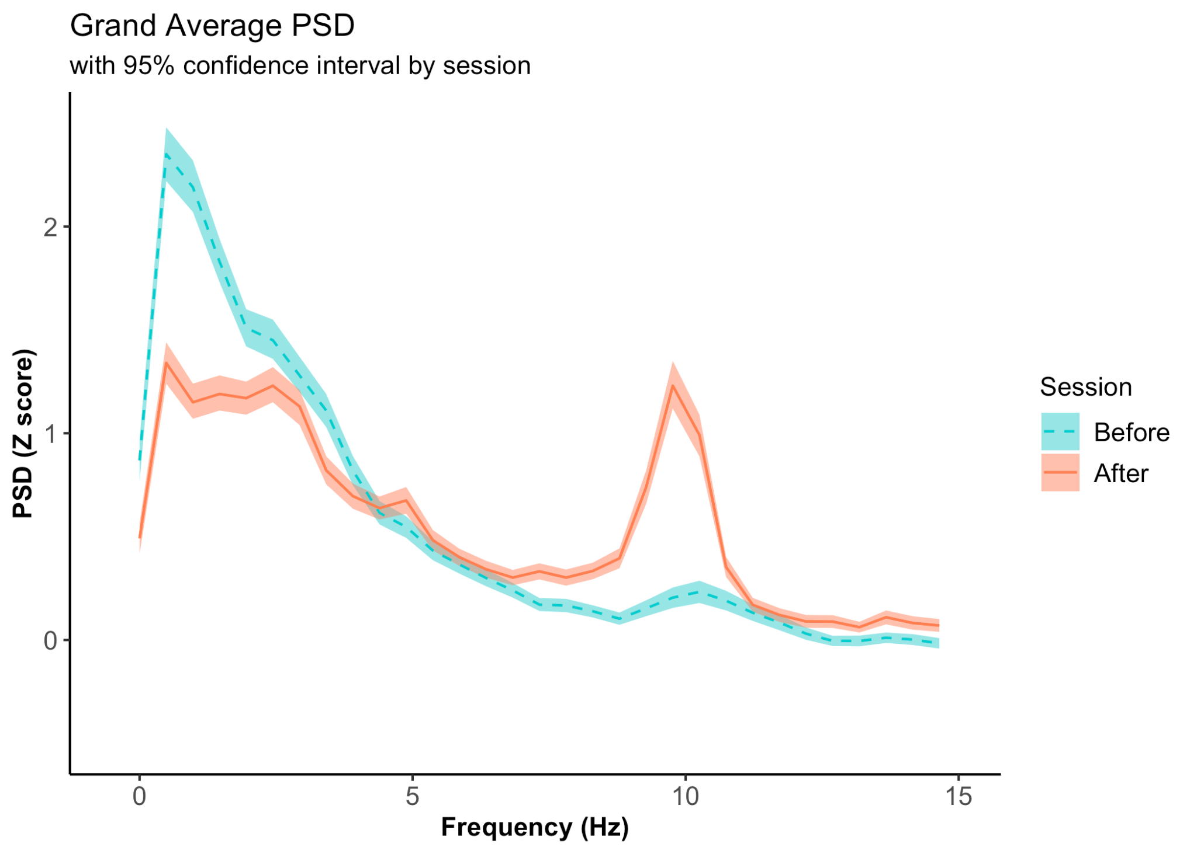
Results (EEG)
Grand Average PSD
Notes:
Not reliable above 15 Hz bec task conditions:
could have included movement (don’t know how stable people are), paper-based measurement sensitive for higher frequencies (beta, gamma), so we won’t consider those
Hypotheses were only regarding alpha so our analysis focuses on theta, alpha range

Slide 21
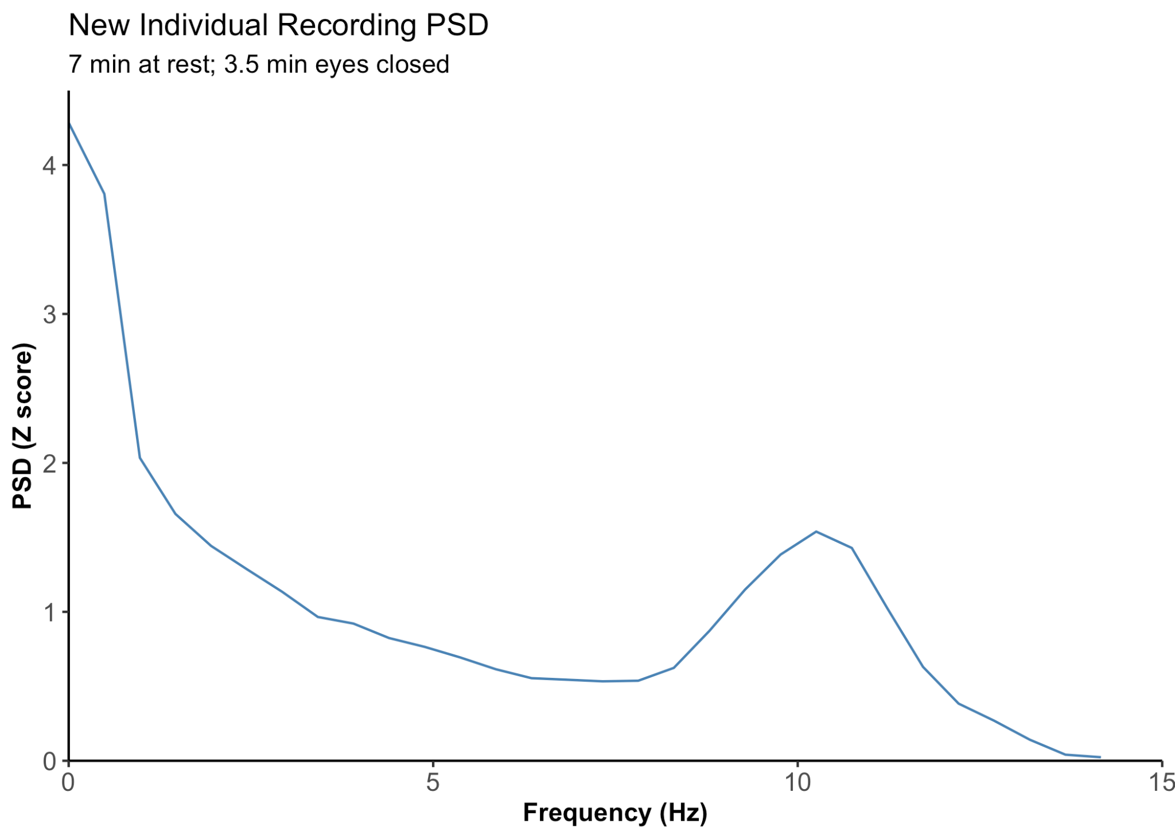
Results (EEG)
One recording in our laboratory
7 min at rest; 3.5 min eyes closed
Similarity of PSD → Digitized data maintain the integrity of brain signals
Notes:
PSDs from digitized EEG and new recordings showed similar characteristics over the theta-to-beta range (4-15Hz), with most sessions featuring a small theta or alpha peak. Alpha power after the class increased significantly (paired t-test), whereas Seashore and Betts scores did not. Recent literature finds that increased alpha power appears during meditation at frontal and occipital locations (Deolindo, 2020) and that state-related alpha-power changes during meditation are more reliable than long-term training effects in experts during rest (Cahn & Polich, 2006). Also, null results for the Seashore and Betts tests are not surprising given that participants did not specifically train the skills they measured. Lastly, recent studies have found that mindfulness training can provide benefits against music performance anxiety and enhanced focus during practice rather than musical skills (Lin et al., 2008).
PSDs similar so our digitized data maintained integrity of brain signals
High level of individual variation // 4 plots of individual subjects before and after
GA psd before vs after // 1/f decreases as freq increases
Current recording PSD similar
Not reliable above 15 Hz bec task conditions:
could have included movement (don’t know how stable people are), paper-based measurement sensitive for higher frequencies (beta, gamma), so we won’t consider those
Hypotheses were only regarding alpha so our analysis focuses on theta, alpha range

Slide 22
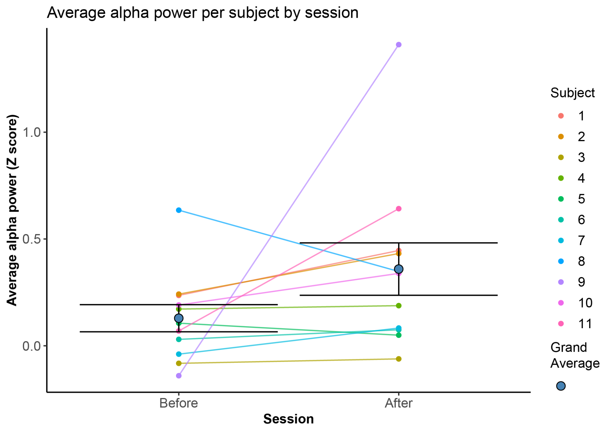
Results (EEG - alpha)
Alpha power after the class increased significantly (paired t-test)
Notes:
PSDs from digitized EEG and new recordings showed similar characteristics over the theta-to-beta range (4-15Hz), with most sessions featuring a small theta or alpha peak. Alpha power after the class increased significantly (paired t-test), whereas Seashore and Betts scores did not. Recent literature finds that increased alpha power appears during meditation at frontal and occipital locations (Deolindo, 2020) and that state-related alpha-power changes during meditation are more reliable than long-term training effects in experts during rest (Cahn & Polich, 2006). Also, null results for the Seashore and Betts tests are not surprising given that participants did not specifically train the skills they measured. Lastly, recent studies have found that mindfulness training can provide benefits against music performance anxiety and enhanced focus during practice rather than musical skills (Lin et al., 2008).
Show Grand mean PSD 0-15 Hz

Slide 23
Results (Literature - alpha)
1970s
EEG alpha
Biofeedback showed promise for controlling brain states (Ornstein, 1972)
Mixed results: Higher alpha associated with closed eyes, drowsiness, intoxication, hypnosis, and meditation (Naranjo & Ornstein, 1971), but one study also found no alpha during meditation, only before/after (Das & Gestaut, 1955))
Recent
EEG alpha
increases during meditation at frontal and occipital locations (Deolindo, 2020)
increases with internally focused attention (Fell, 2010)
positively related to amount of creative ideation in a task (Fink & Benedek, 2014)
decreases during improvisation for musicians, but not non-musicians (Berkowitz & Ansari, 2010)
State-related alpha power changes during meditation are more reliable than long-term training effects in experts during rest (Cahn & Polich, 2006)
Notes:
Literature and interpretation: Cut down text to key words
Sonically guided meditation or just meditation => musical skills?
Passive listening common in meditation practice
Did we find much in 70s? If not, then our interpretation is that paradigm could be updated
Same with EEG
Oliveros’ hypotheses regarding alpha power most likely came from psychologist Robert Ornstein, whose 1972 book she cites in her published bibliography for the Meditation Project. In the book, Ornstein oversimplifies the association between meditation and alpha oscillations and the promise of biofeedback alpha training for healing the Western mind. Available research at the time associated alpha waves with closed eyes, drowsiness, intoxication, hypnosis, and meditation. The few studies done in the 50s and 60s on alpha and meditation often had few subjects or many subjects but data reported for only select participants.

Slide 24
Conclusions
Oliveros’ behavioral measures may have less support today
Oliveros’ hypotheses regarding alpha power aligned with some findings from the 1970s and appear relevant today
=>
EEG recording paradigm and experimental design could be refined
EEG results vary for different types of meditation techniques and expertise level
Differentiate between state (during meditation) vs. trait (long-term meditation experts at rest) effects
Future work
Examine alpha correlates in state-related sonic meditations
Explore links between musical improvisation and meditation
Notes:
Oliveros’ hypotheses regarding alpha power aligned with findings from the 1970s and appear relevant today, whereas her behavioural measures might have less support. Thus, both the EEG recording paradigm and experimental design could be refined. Recent research paints a more complex picture for different types of meditation techniques and expertise levels, as well as a distinction between state and trait effects. Also, increased alpha power correlates with internally focused attention, such as tone imagery or working memory tasks (Fell, 2010) and creative ideation (Fink & Benedek, 2014).
Future work:
10 weeks not enough training + mixed methods
Even though interest in the cognitive and affective effects of meditation has increased recently, Oliveros’ ideas remain underexplored. We have designed a follow-up study to look at the neural correlates of meditative states inspired by the Sonic Meditations, which may offer a unique lens for understanding the connection between compositional approaches, mindfulness, auditory perception and neurophysiological underpinnings.
Even though interest in the cognitive and affective effects of meditation has increased recently, Oliveros’ ideas remain underexplored. We have designed a follow-up study to look at the neural correlates of meditative states inspired by the Sonic Meditations, which may offer a unique lens for understanding the connection between compositional approaches, mindfulness, auditory perception and neurophysiological underpinnings.

Slide 25
Questions?
Thank you for listening!
Contact: bnerness@ccrma.stanford.edu

Slide 26
References
Andrade, J., May, J., Deeprose, C., Baugh, S.J., Ganis, G. (2014). Assessing vividness of mental imagery: The Plymouth Sensory Imagery
Questionnaire. British Journal of Psychology 105, 547-563
Berkowitz, A. L. & Ansari, D., (2010). Expertise-related deactivation of the right temporoparietal junction during musical improvisation. NeuroImage, 49,
712–719]
Campos, A. & Fuentes, L. (2016). Musical Studies and the Vividness and Clarity of Auditory Imagery. Imagination, Cognition, and Personality:
Consciousness in Theory, Research, and Clinical Practice 36(1), 75-84
Cahn, B. R. & Polich, J. (2006). Meditation states and traits: EEG, ERP, and neuroimaging studies. Psychological Bulletin
132(2), 180-211
Das, N. N., & Gastaut, H. C. (1955). Variations de l’activite electrique du cerveau, du coeur et des muscles squelletiques au cours de la meditation et de
l’extase yogique. [Variations of the electrical activity of the brain, heart, and skeletal muscles during yogic meditation and trance.] Elec-
troencephalography and Clinical Neurophysiology, (Suppl. 6), 211–219
Deolindo, C. S., Ribeiro, M. W., Aratanha, M. A., Afonso, R. F., Irrmischer, M., & Kozasa, E. H. (2020). A critical analysis on characterizing the
meditation experience through the electroencephalogram. Front. Syst. Neurosci 14(53).
Fell, J., Axmacher, N., & Haupt, S. (2010). From alpha to gamma: electrophysiological correlates of meditation-related states of consciousness. Medical
Hypotheses 75(2010), 218-224. doi:10.1016/j.mehy.2010.02.025
Fink, A. & Benedek, M. (2014). EEG alpha power and creative ideation. Neuroscience & Biobehavioral Reviews 44, 111–123
Lin, P., Chang, J., Zemon, V., & Midlarsky, E. (2008). Silent illumination: a study on Chan (Zen) meditation, anxiety, and musical performance quality.
Psychology of Music 36(2), 139-155.
Naranjo, C., & Ornstein, R.E. (1971). On the Psychology of Meditation. New York: Viking Press. (page numbers??)
Oliveros, P. (1971). Sonic Meditations. Smith Publications.
Oliveros, P. (1984). Software for People: Collected Writings 1963-80. Unpub Editions.
Oliveros, P. (2007). My ‘American Music’: Soundscape, Politics, Technology, Community. American Music (25)4, 389-404.
Ornstein, R.E. (1972).The Psychology of Consciousness. New York: Viking.

